Slide 1
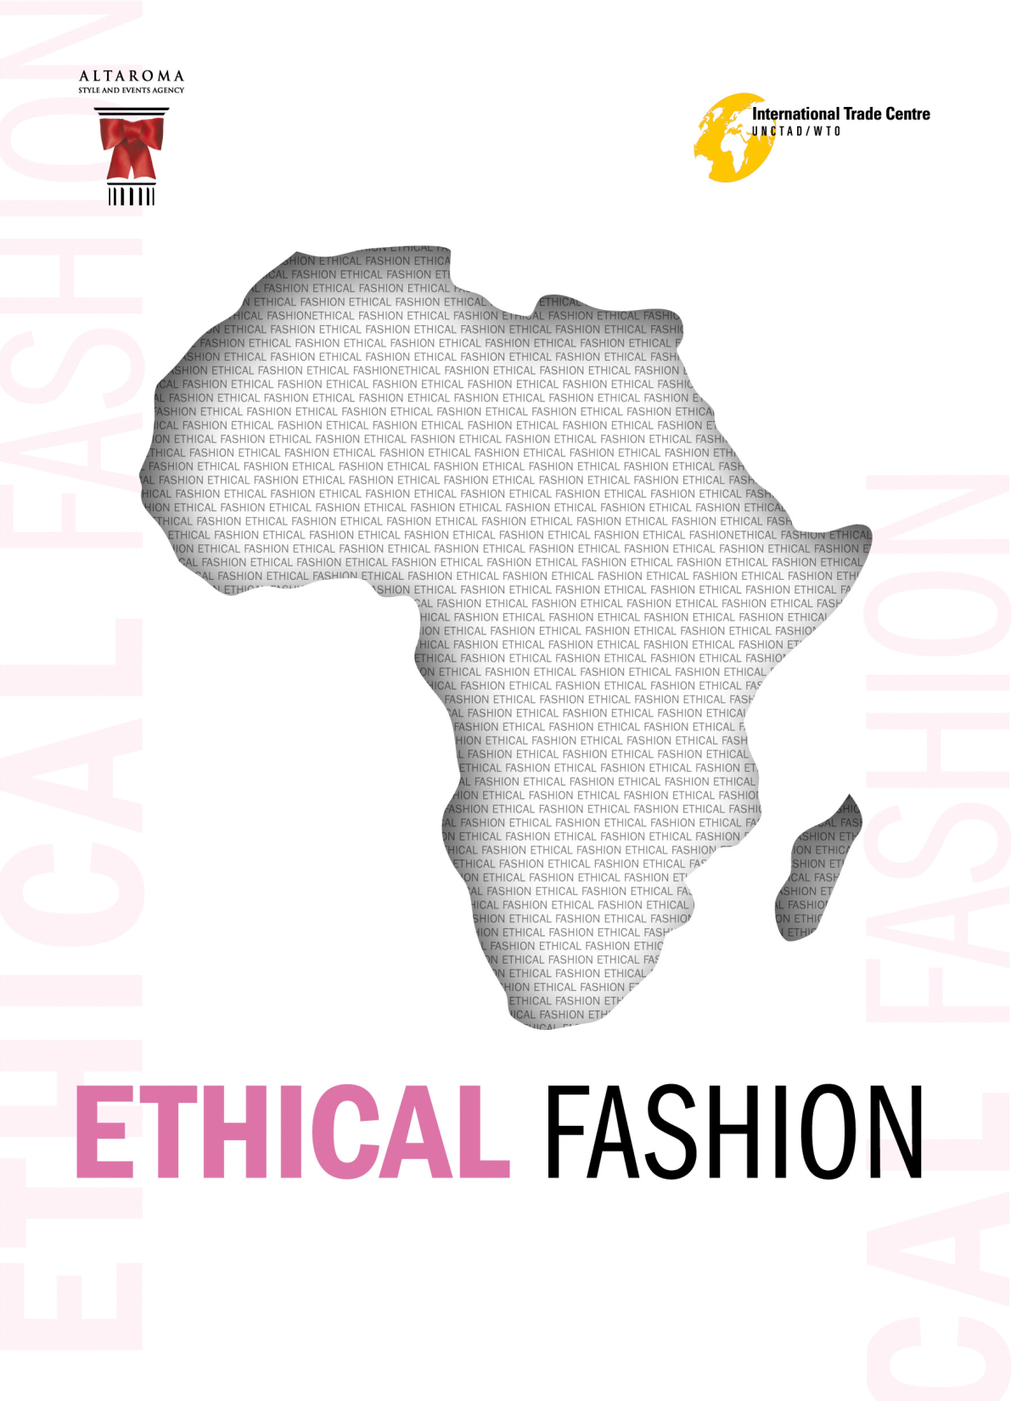
The Design of New Prosperity and Better Lives: A Workshop for a “Food-Shelter-Clothes” Birth to Birth System.
Cittadellarte, Biella, Italy 15, 16, 17 (and 18) October 2010

Slide 2
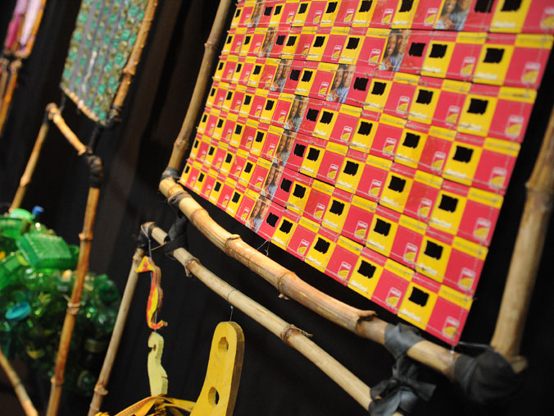
ALTA ROMA
The Company
Alta Roma is a syndicated joint stock company. Its shareholders are the Chamber of Commerce of Rome together with the Region Lazio, the Municipality of Rome, the Province of Rome, (the main government authorities of the Lazio territory)
Born in 1998 as “Agenzia per la Moda” it becomes in 2002 the institutional tool to promote the image and culture of Rome on the international fashion scene.
Supporting the High Fashion around the world means to express the precise will to fine tune Rome’s potentialities in terms of beauty, creativity, style and tradition.
Aims
High Fashion represents a great link between roots and contemporaneity and implies a whole set of artisanal talents, arts and crafts which creates a universal language.
An excellent keystone, a proper Italian cultural asset which originates all the fashion aspects creating a value added: the Made in Italy.
Alta Roma takes an active part in offering an opportunity to young designers to be presented to a critical audience, to company representatives and, above all, to entrepreneurs operating in the field of fashion.

Slide 3
ITC AND ALTA ROMA PARTNERSHIP
High fashion is a cultural heritage and includes a whole set of values which are slowly disappearing due to the massive requirements of the market. The safeguard of ancient crafts is yet another of our priorities.
Nowadays the luxury segment of the fashion industry has rediscovered that hand made products, quality and natural materials.
Alta Roma is also involved in promoting projects linked to underprivileged social classes as the role of fashion ceases to be a mere vehicle for luxury and style, while becoming a tool to promote social responsibility. A job in the fashion field may prove to be a significant support.
The partnership (since Jan 2008) between Alta Roma and ITC (International Trade Centre), the joint technical cooperation agency of the United Nations and WTO (World Trade Organization) was a natural evolution. A high level of scouting is again a crucial element to develop a project finalized to poverty reduction in disadvantaged communities.

Slide 4
WHY ETHICAL FASHION
Trends of western markets (especially in the sector of high range consumer goods, design and luxury, including clothing, textiles, jewellery, footwear and accessories) have opened up new opportunities for small and micro entrepreneurs in developing countries. Consumers are very alerted on the product’s link to ethical issues, such as human rights, social justice, and the environment.
Ethical shopping influences the trend of high range goods so that marketing gurus have acknowledge the birth of a new segment: ethical fashion.
The features of ethical fashion products partially overlap with those required in mainstream fashion: high quality and design in compliance with ‘ethical expectations’. Consumers are willing to pay a premium for ethical products as long as those features influence the positive development and environment impact.

Slide 5
AIMS
A significant impact in terms of poverty reduction can be obtained supporting the development of the “ethical fashion” segment, which means:
Support in the building of professional skills on site, the creation of special support structures and the sending of a team of social workers and experts in the field to sustain management of the production process.
Support in the realization of all the process’s steps, from the sketch to the final product.
Guarantees on the quality standard, on product ‘s supply, on the reliability between costs and profits.
Providing equal pay, Fair wages and non-hazardous working conditions, as well as a respect for workers’ rights.
Working conditions; ensuring that producers are working in a healthy and safe place (no use of toxic pesticides and chemicals; a minimum use of water; improved energy efficiency, recycling and waste).

Slide 6
ACTIVITIES
Altaroma ad ITC have promoted, through a series of communication activities, mainly set in ALTAROMALTAMODA fashion weeks, a network that involve the fashion community in developing sustainable economic relations between the Italian fashion system and the disadvantaged communities.
Trough the informations provided, fashion companies can put in a request for components of clothing or accessories, or raw or ecological materials with a view to subsequently assembling them in compliance with the standards and quality controls generally accepted in the sector. Fashion designers can enstablish fluid relationship with community of african workers to produce items or collections, under the coordination of Altaroma and ITC.
Today, Ethical Fashion involves 3,500 individuals (+ 400% compared to July 2009), all micro-manufactures, 95% of whom are women, living in conditions of extreme marginalization and poverty, who have banded together in 39 groups in order to pool their strengths and to set up real cooperatives.

